Slide 1

Routine Correspondence
Memos, Letters, E-Mails Messages, Instant Messages and Text Messages

Slide 2
Instant Messages/ Text Messages
Text messaging and instant messaging are similar because they are both used to send text messages.
However, text messaging ("texting") uses the cellular phone service, whereas instant messaging employs the Internet.
Text messages are typically limited to 160 characters, but instant messages can be longer.

Slide 3
Benefits of Instant Messages/ Text Messages
Increased speed of communication.
Improved efficiency for geographically dispersed workgroups.
Collaboration by multiple users in different locations.
Communication with colleagues and customers at a distance in real time.
Avoidance of costly long distance telephone rates.
More personal link than e‐mail.
Communication channel that is less intrusive than telephone calls.
Communication channel that allows for multitasking.
Quick way to find out who is in the office, out of the office, available for conversation, or unavailable due to other activities.

Slide 4
Challenges of Instant Messages
Security issues. IM users are vulnerable to hackers, electronic identity theft, and uncontrolled transfer of documents.
Lost productivity. Use of IM on the job can lead to job downtime. First, we tend to type more slowly than we talk. Next, the conversational nature of IM leads to “chattiness.” If employees are not careful, or monitored, a brief IM conversation can lead to hours of lost productivity.
Employee abuse. IM can lead to personal messages rather than job‐related communication with coworkers or customers.
Distraction. With IM, a bored colleague easily can distract you with personal messages, online chats, and unimportant updates.
Netiquette. As with e‐mail, due to the casual nature of IM, people tend to relax their professionalism and forget about the rules of polite communication. IM can lead to rudeness or just pointless conversations.
Spim. IM lends itself to “spim,” instant message spam—unwanted advertisements, pop‐ups, and viruses.

Slide 5
Techniques for Successful Instant Messages
Choose the correct communication channel.
Summarize decisions.
Tune in, or turn off.
Limit personal use.
Never use IM for confidential communication.

Slide 6
IM/TM Corporate Usage Policy
Train employees to use IM and TM effectively for business.
Explain which services are allowable in the workplace.
Do not allow employees to store IM or TM passwords on computer desktops or other sites easily accessed.
Install appropriate security measures, including automated encryption, to protect against external threats, such as spam, spim, and viruses.
Log and archive instant messages and text messages for compliance to company policy.

Slide 7
Letters: Essential Components of Letters
Writer’s Address
Date: Place the date one or two spaces below the writer’s address.
Reader’s Address: Place the reader’s address two lines below the date.
Salutation: Placed two spaces beneath the inside address.
Letter Body: Begin the body of the letter two spaces below the salutation.
Complimentary Close: Place it two spaces below the concluding paragraph.
Signed Name: Sign your name legibly beneath the complimentary close.
Typed Name: Type your name four spaces below the complimentary close.

Slide 9
Optional Components of Letters
Subject Line.
New‐Page Notations.
Writer’s and Typist’s Initials.
Enclosure Notation.
Copy Notation.

Slide 10
Reasons for Writing Memos, E-Mails & Letters
Documentation- expenses, incidents, hiring, firings, problems encountered reallocations of staff or equipment
Confirmation-a meeting agenda, date, time and location, conclusions, cost etc.
Procedures- how to set up accounts, use a software, machine etc.
Recommendations-reasons to purchase new items, fire or hire personnel etc.
Feasibility-Study the possibility of changes in the workplace
Status-daily, weekly, monthly, quarterly, biannually, yearly statements about progress
Directive (delegation of responsibility)- Informing subordinate about their tasks
Inquiry-about upcoming procedures/ products
Cover-prefacing an internal proposal, long report and other attachments

Slide 11
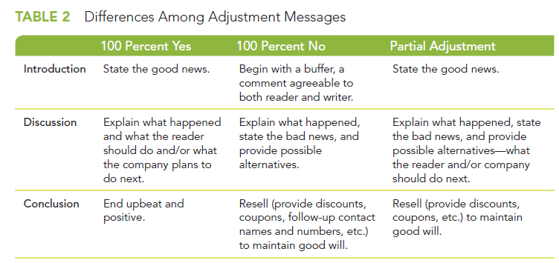

Slide 12
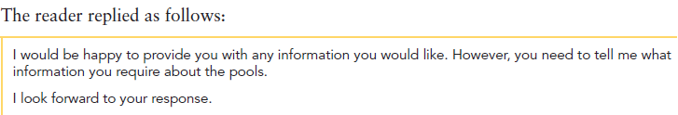
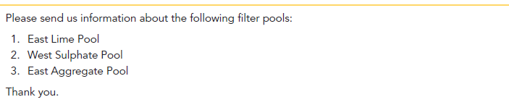
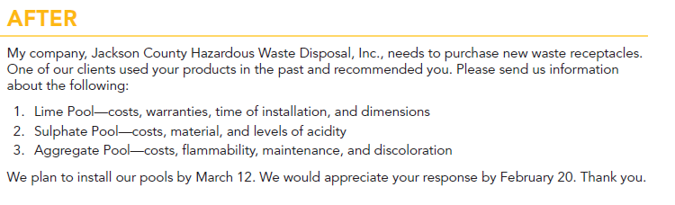

Slide 13
Refusals
Here are some guidelines for writing a refusal:
State your subject.
Summarize your understanding of the facts.
Deliver the bad news, explaining your reasoning.
Offer any alternatives, if they are available.
Express a desire to retain the relationship.
Provide contact information.

Slide 15

Any Questions?

